Slide 1
Grayson Beckert
CS 232 Final Project Presentation

Slide 2
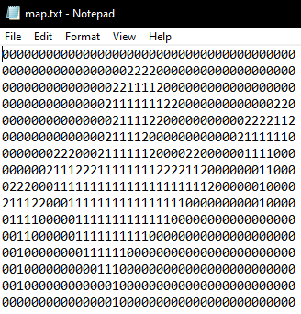
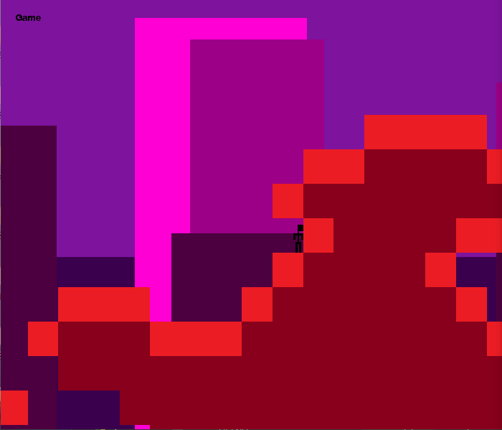
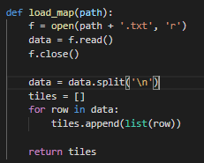
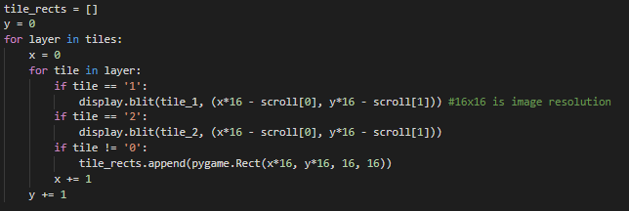
The Coolest Part:
Map Creation -
Read through text file, numbers correspond to different textures
Easy to expand/create own map
More numbers = more textures

Slide 3
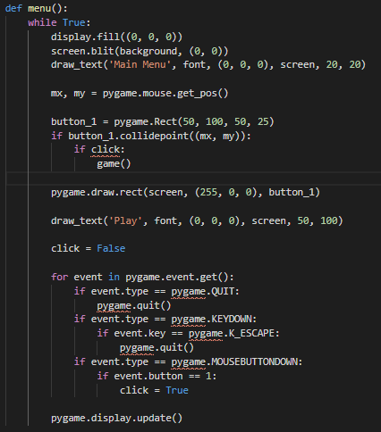

Code I’m Most Proud of:
Main Menu -
While simple and not very pretty, I was happy with the end result of my game’s main menu
Easily expandable for things like options menu/other games/modes

Slide 4
If I could do it all over again, I would…
Be More Outgoing -
I had a number of other ideas but went for the more simplistic, well documented path of a simple PyGame platformer
Didn’t really know what I wanted to do at first and sat on a couple ideas for a while
Try out a library that we hadn’t already used in a previous assignment

Slide 5
A Few Things I Learned...
I Learned a Lot About PyGame and Python -
I followed a number of different tutorials and ran into problems that I never faced in our previous PyGame assignment
Making a game as simple as this further showed how complicated some of my favorite games are
Did things I had previously only done in C++ in this project

